Slide 1
Proposals
2/2/2023

Slide 2
Overall impressions of your proposals
Recommendation: Resubmit with minor revisions
Excellent on worth-doing
I asked many of you for more discussion of do-able
Timeline, Deliverables: What are we going to get when?
What do you hope to have for the midpoint review (and final review)?
Specifics on resources: data, compute, etc.
Some expressed concerns about your technical capabilities
Feel free to request one-on-one (virtual) meetings
Homework for next week
Resubmit with minor revisions
Provide a status update (progress so far)

Slide 3
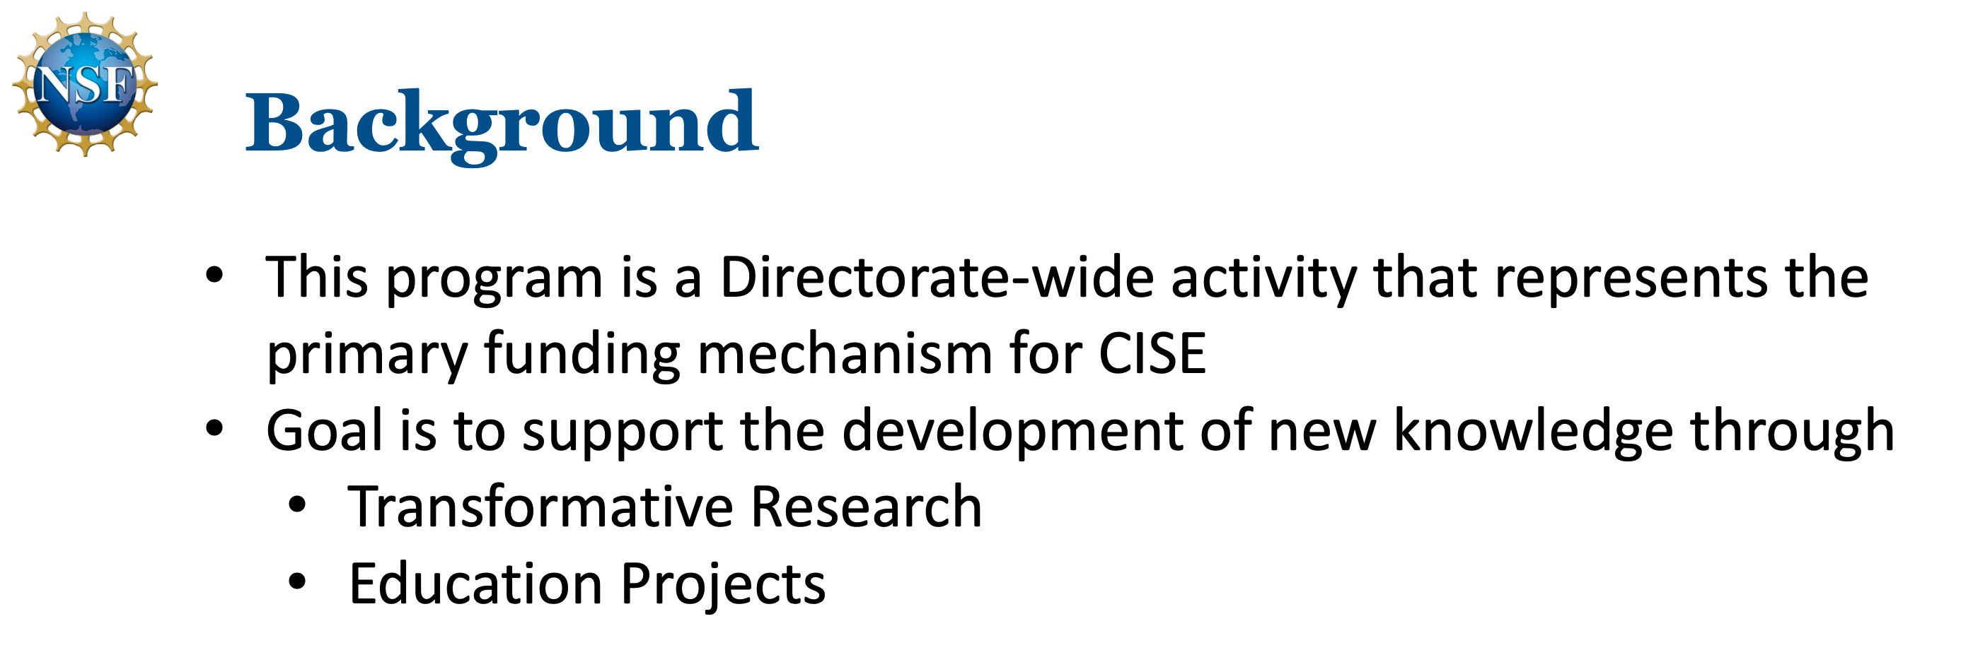
Government uses lots of acronyms/terms (and forget that we don’t all know what they mean)

Slide 4
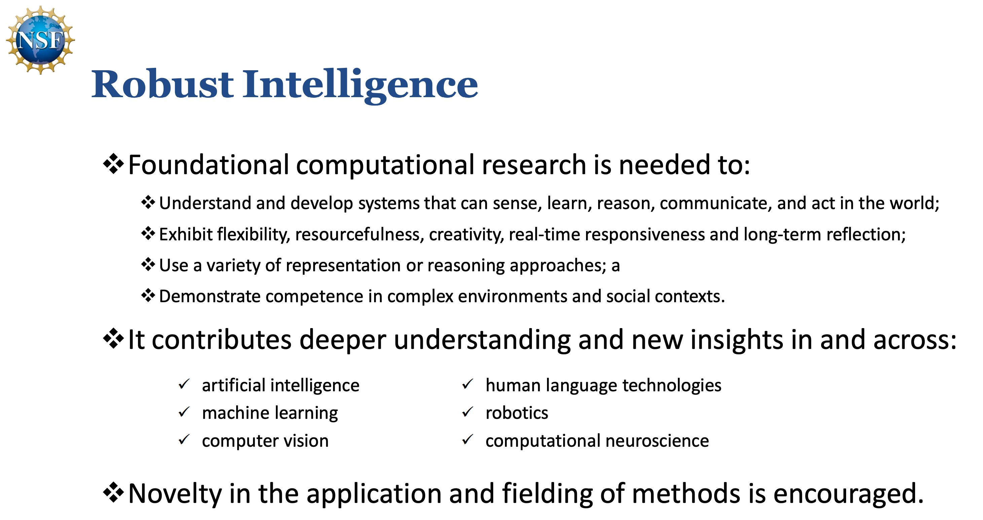

Slide 5
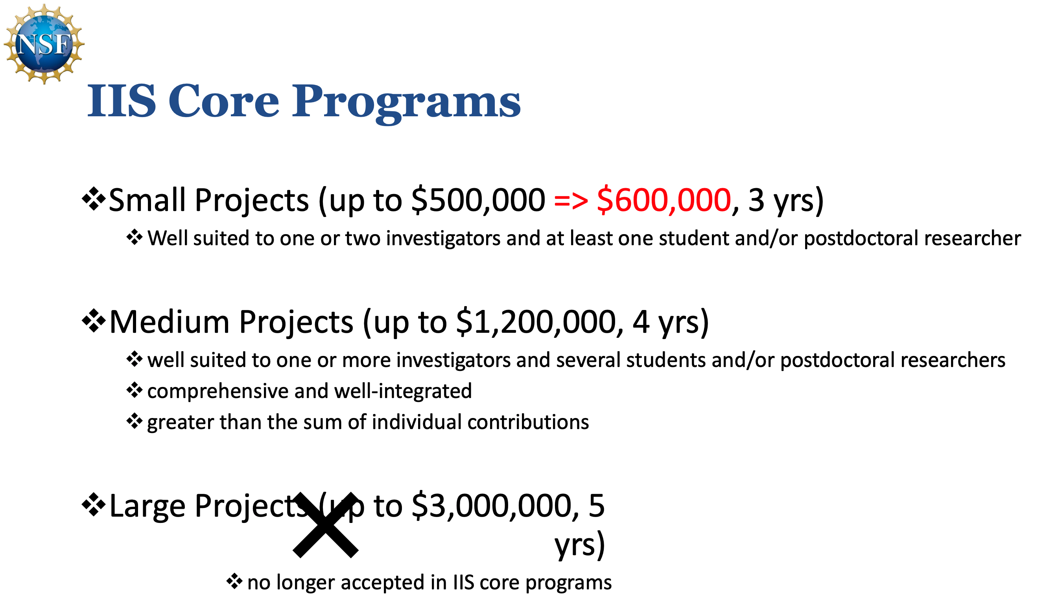

Slide 6
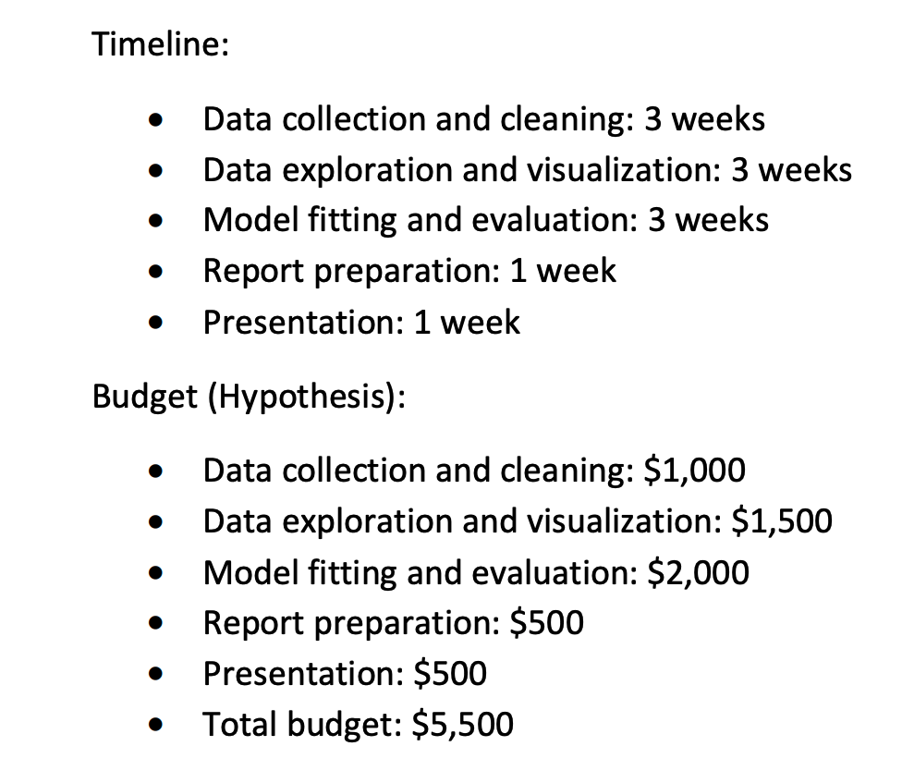

Slide 7
Timelines
Is this schedule realistic?
Likely to meet schedule?
Likely to meet budget?
What will we have for
Midpoint Review (March 16)
6 weeks from today
Final Review (April 20)
5 weeks from Midpoint
6 weeks
5 weeks
11/52 weeks = 20% head count
loaded head = 3 unloaded heads
if this is 1 of 4 classes → 5% head count
@$300k/head, 5% head = $15k

Slide 8
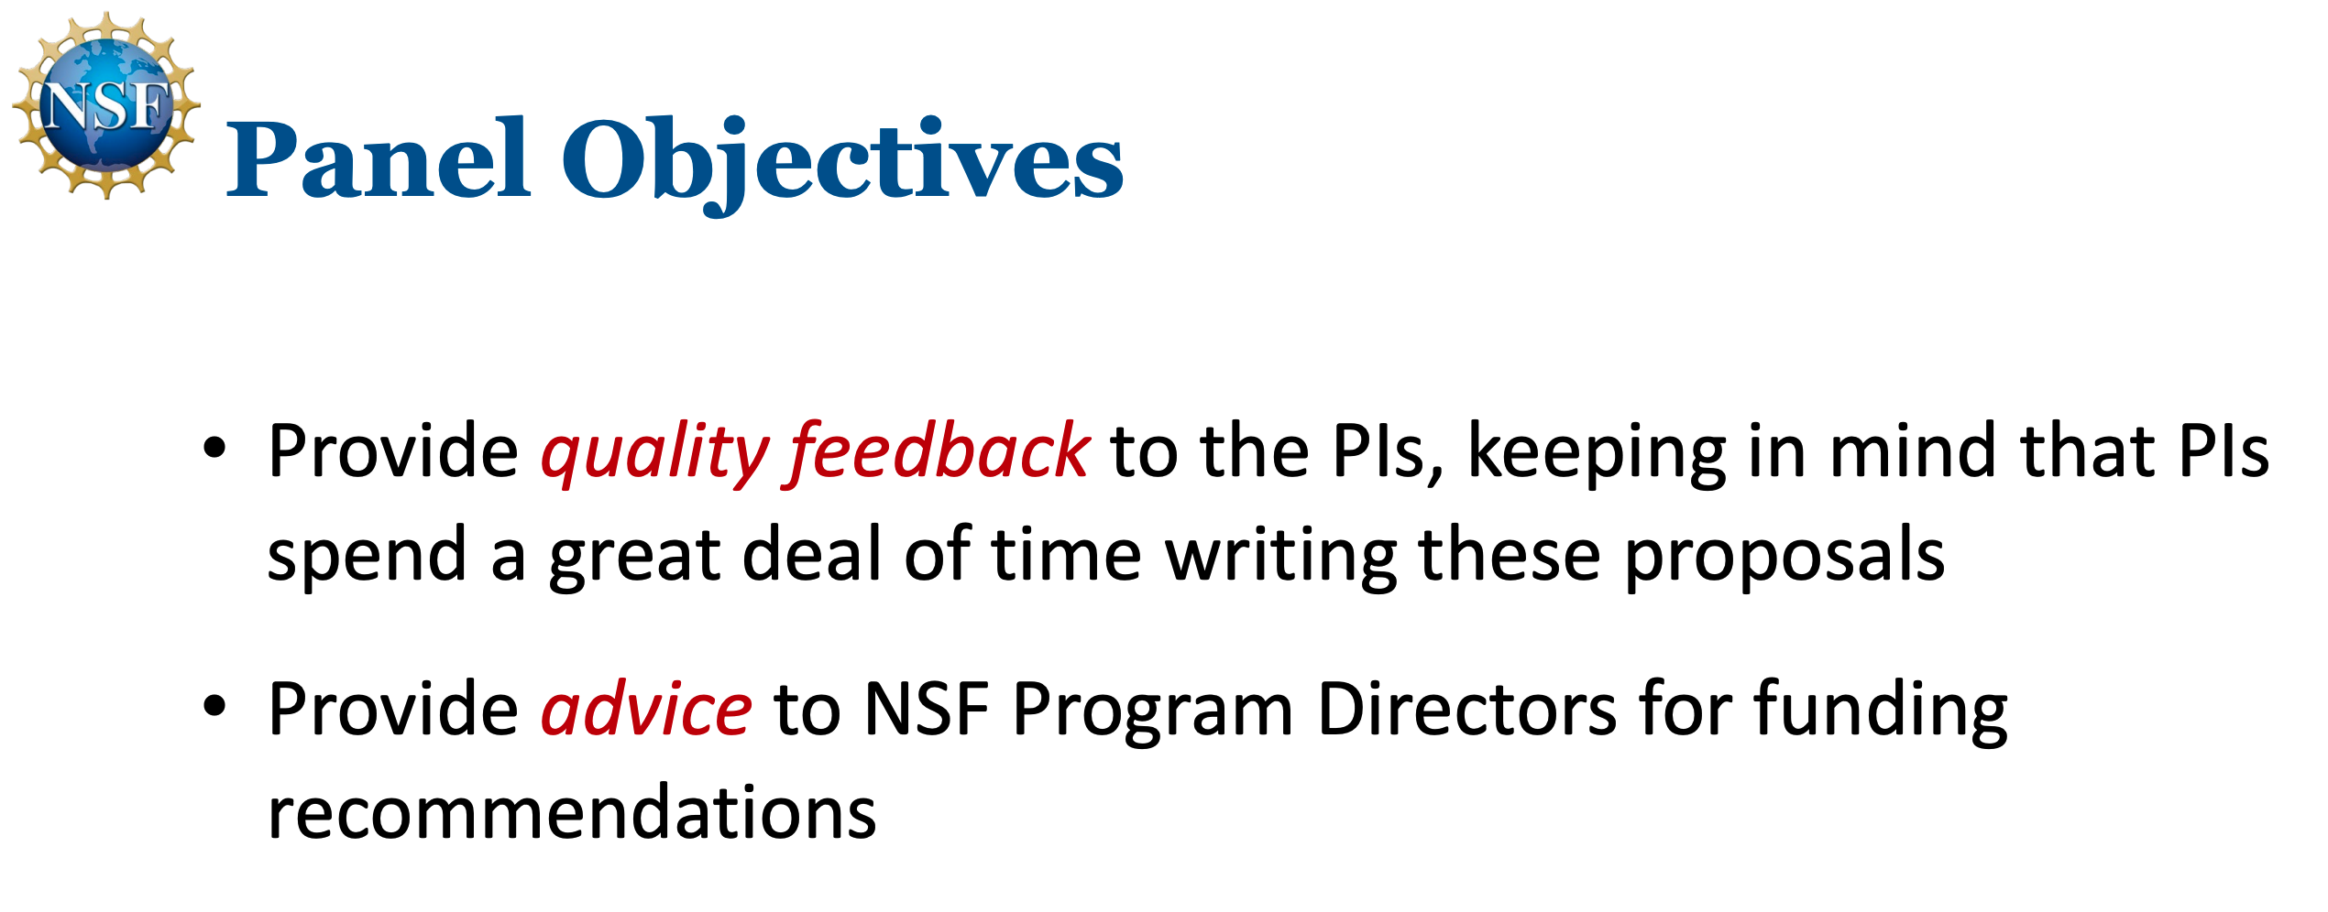

Slide 9
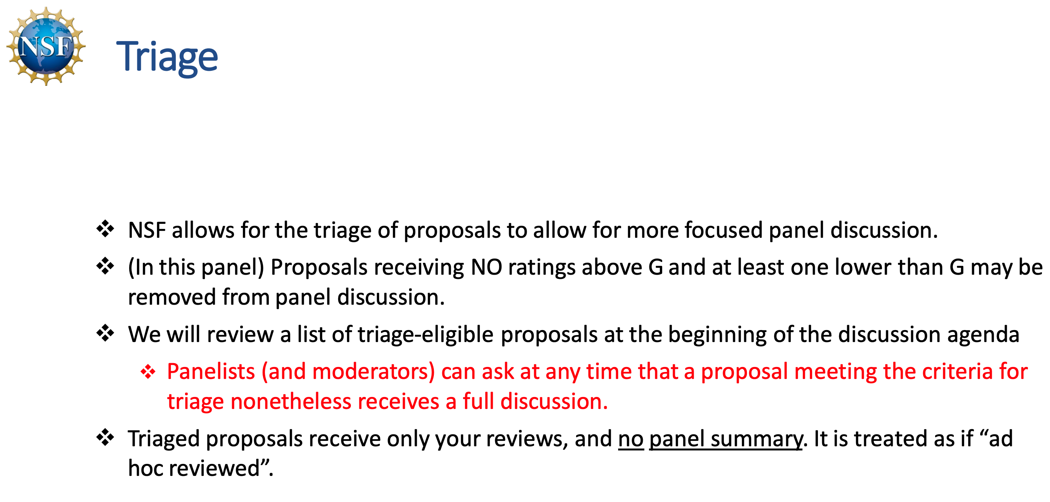

Slide 10
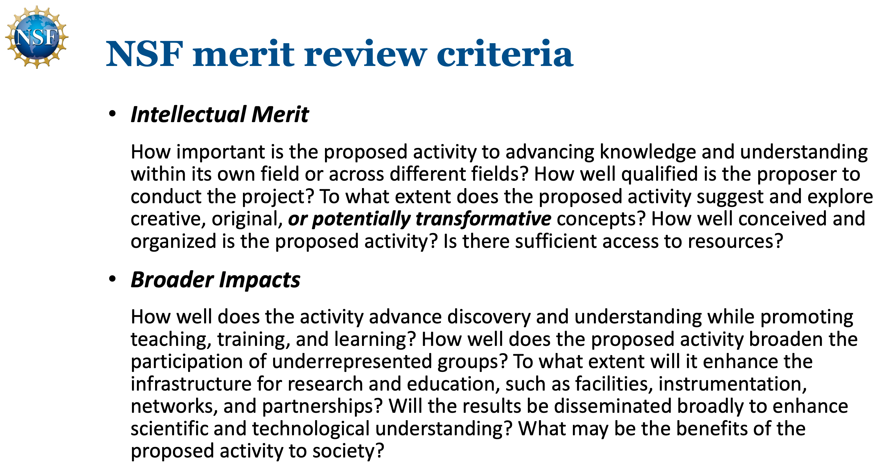

Slide 11
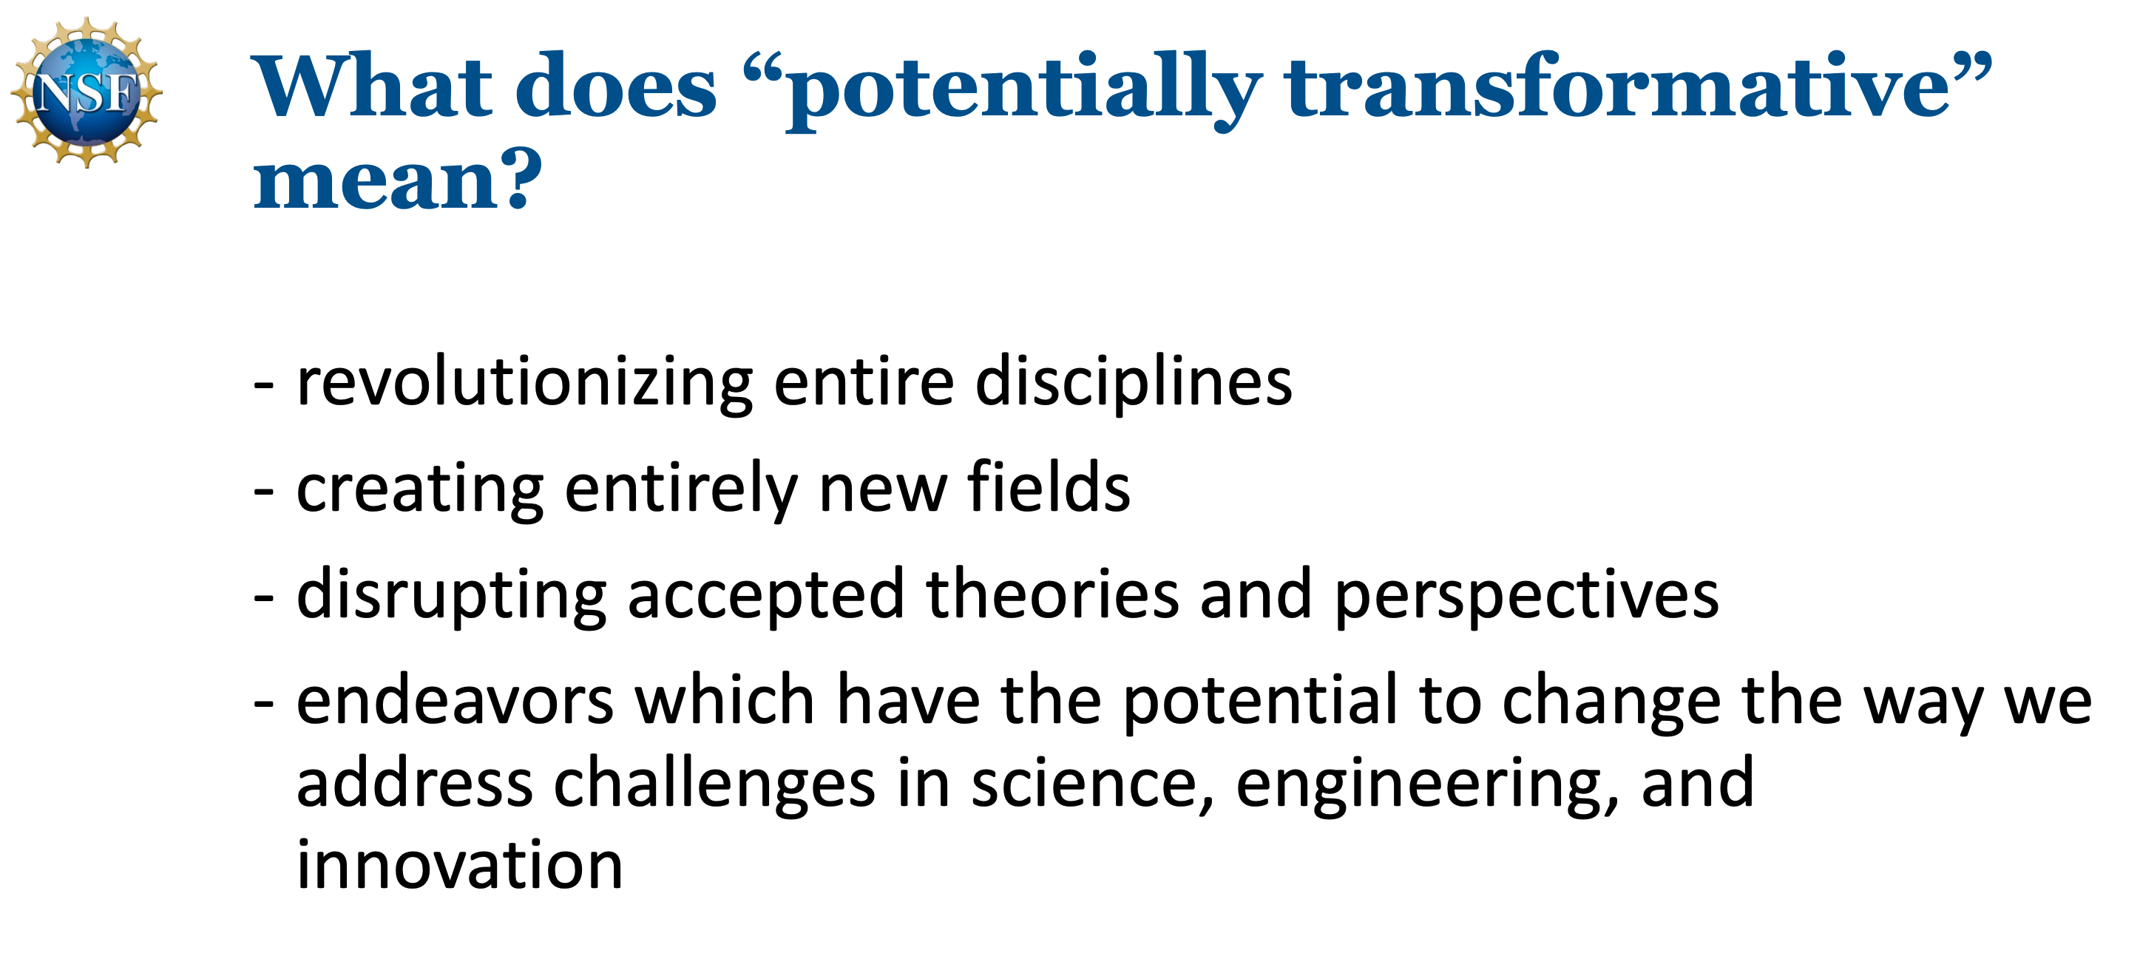

Slide 12
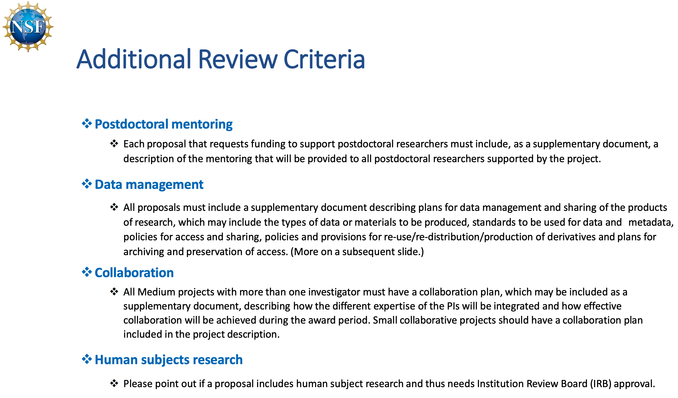

Slide 13
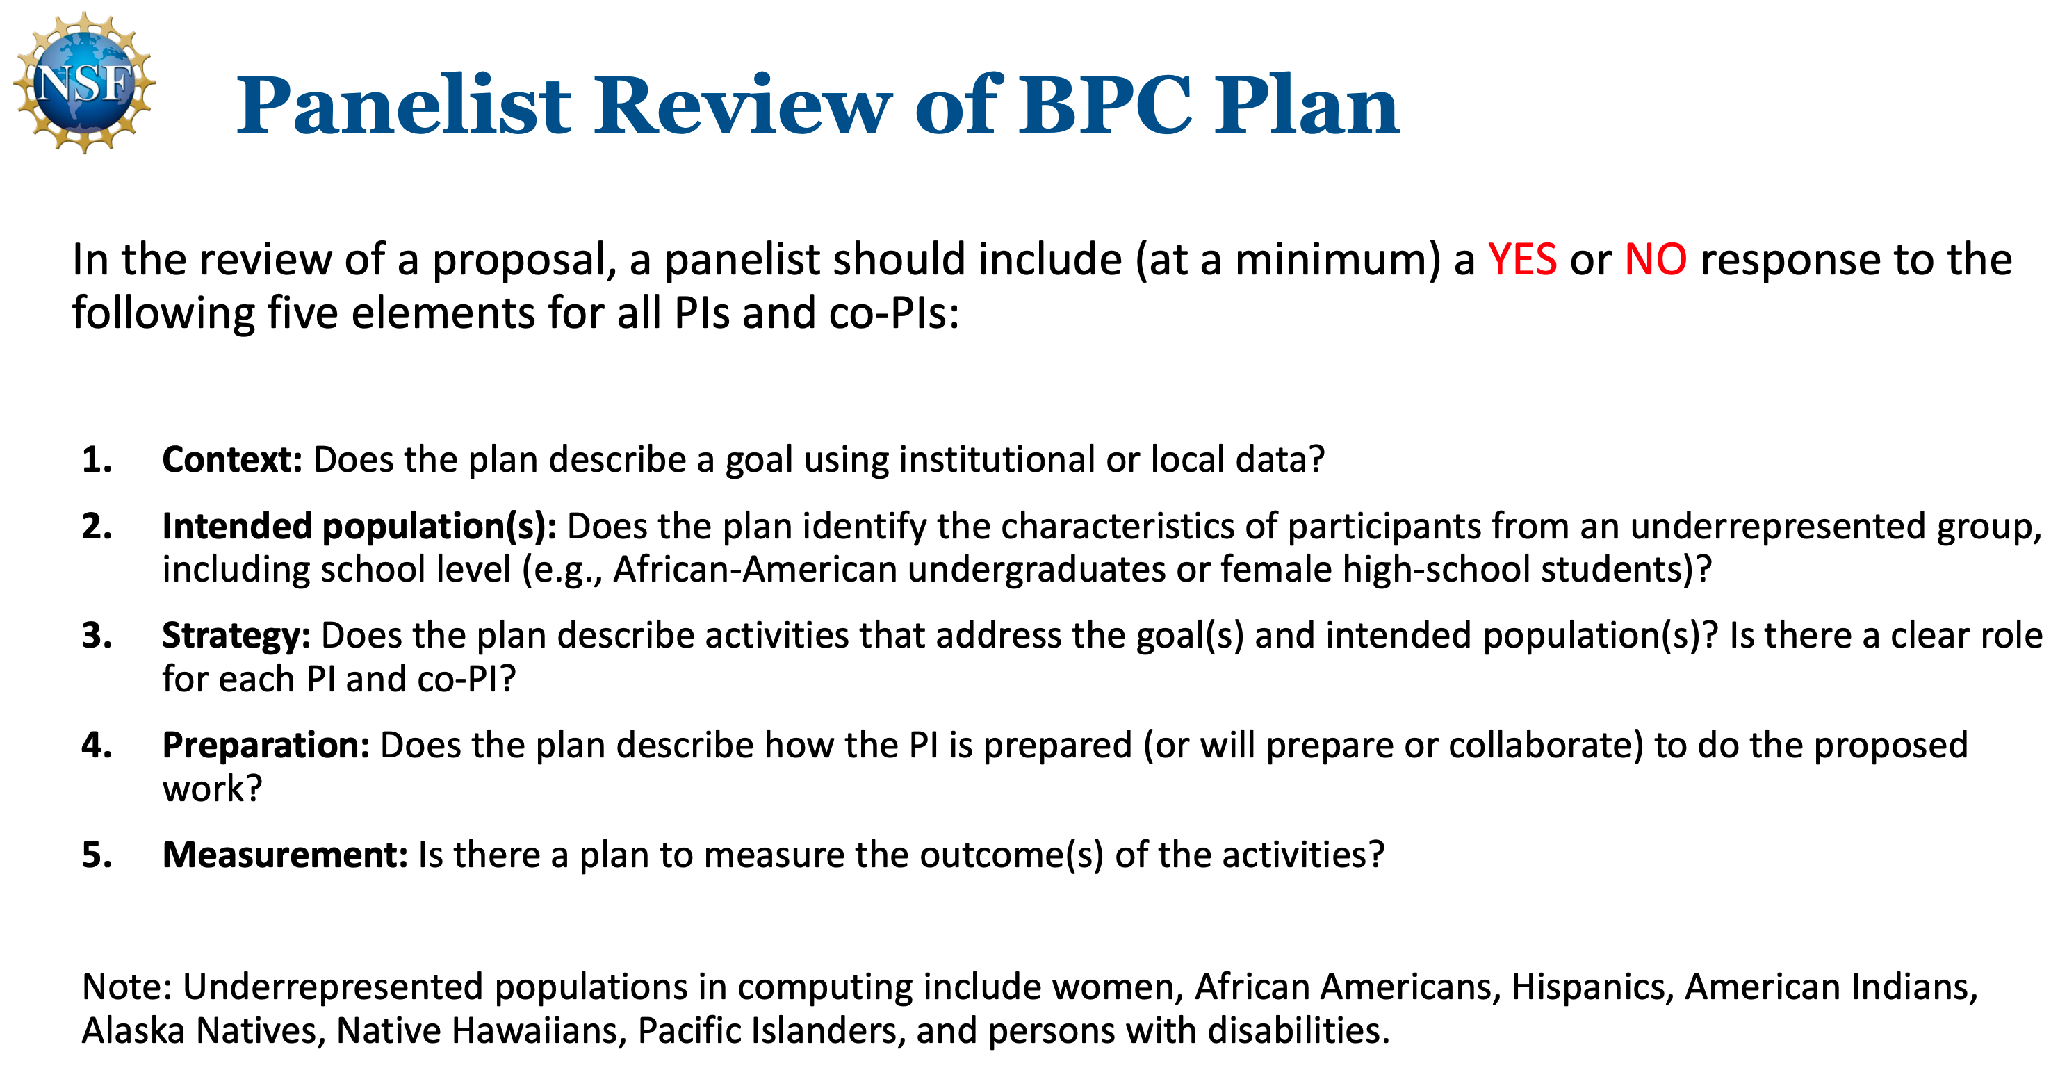

Slide 14
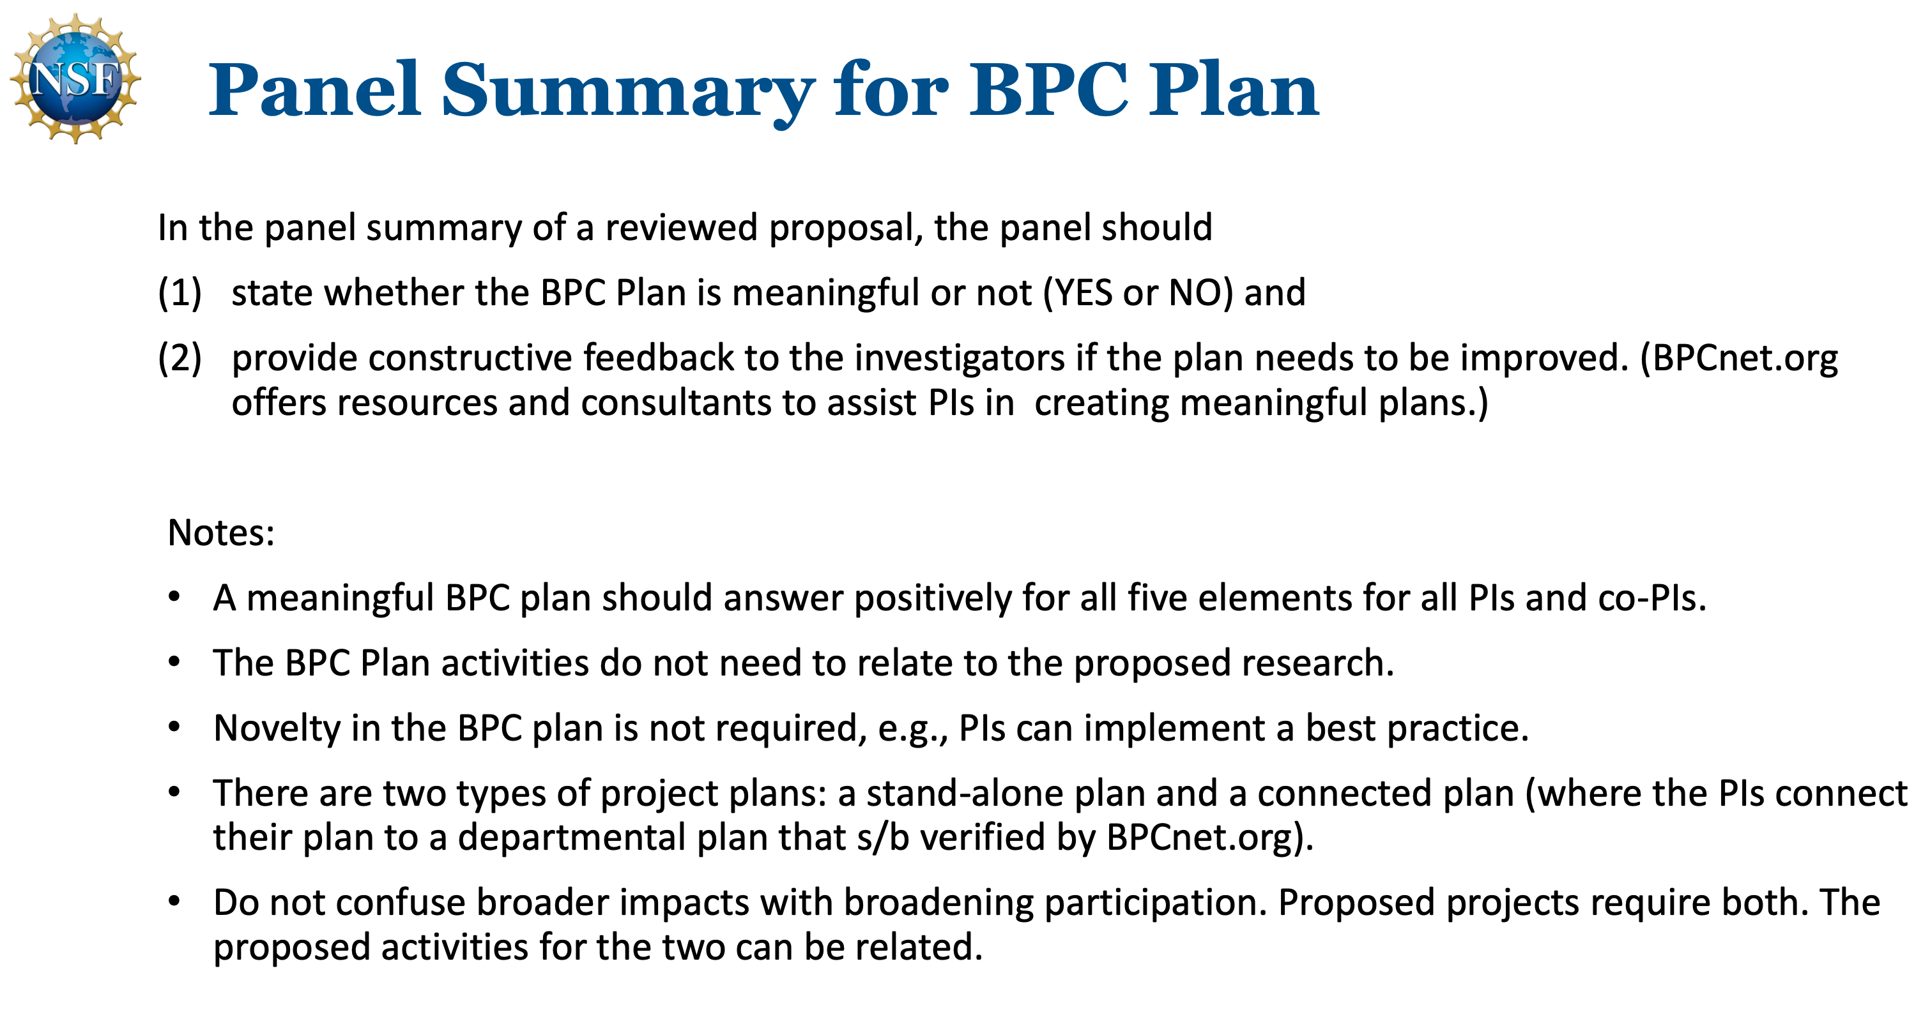

Slide 15


Slide 16
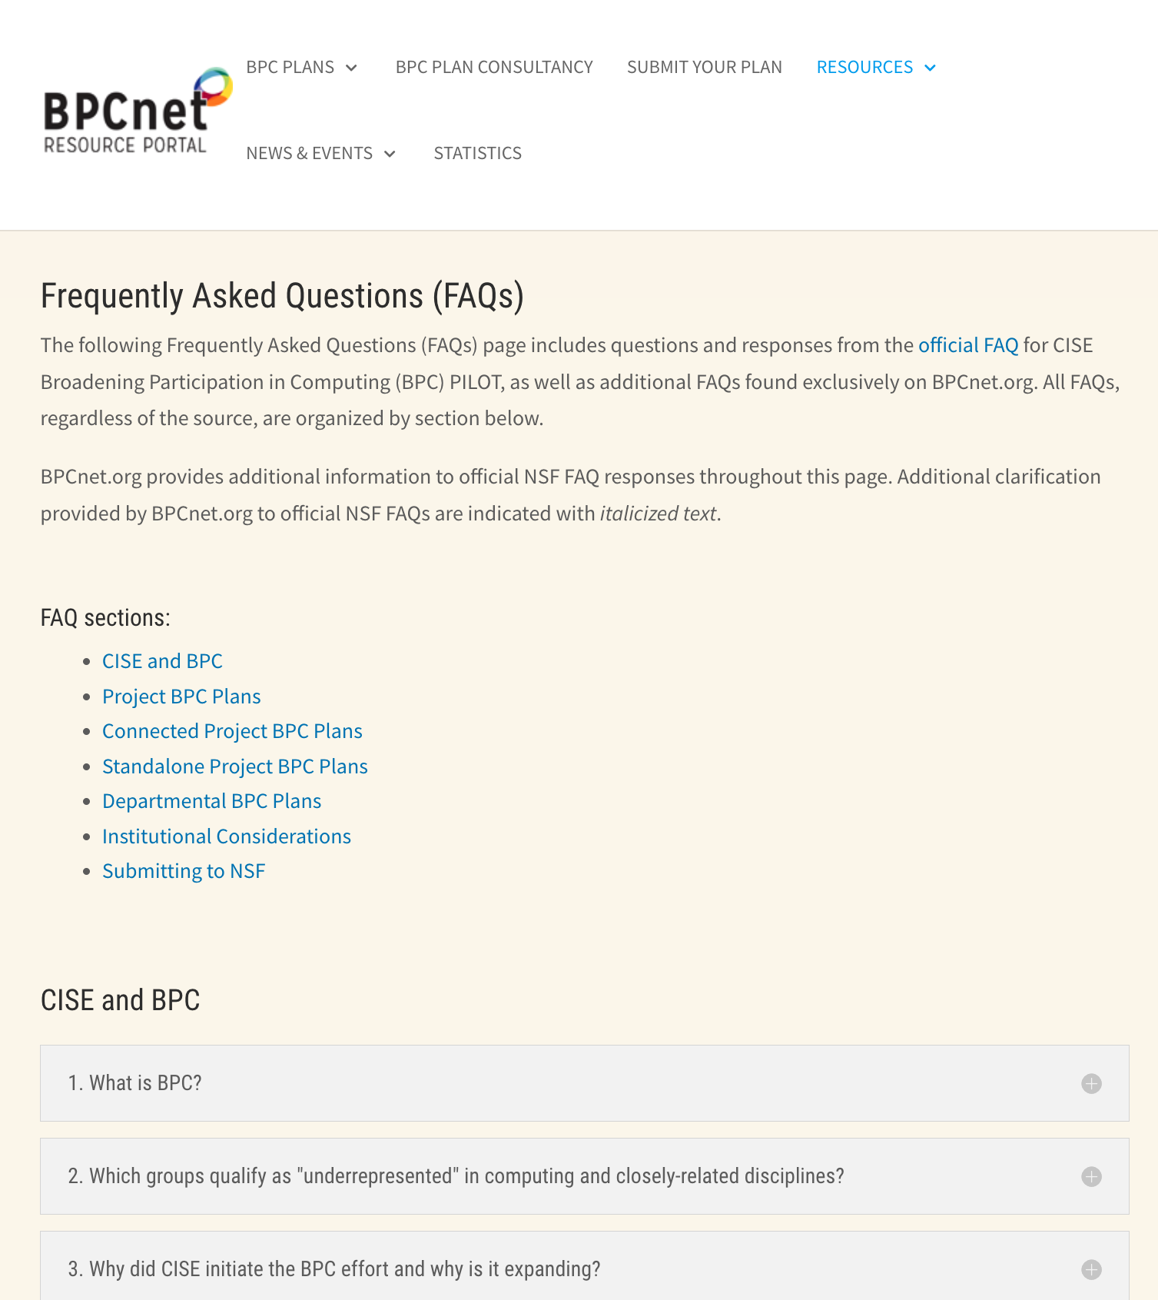
FAQs should be more actionable (to target audience)
What can I do
to make the world a better place in terms of diversity?
What can I do
to increase the chances that my proposal will be funded?

Slide 17
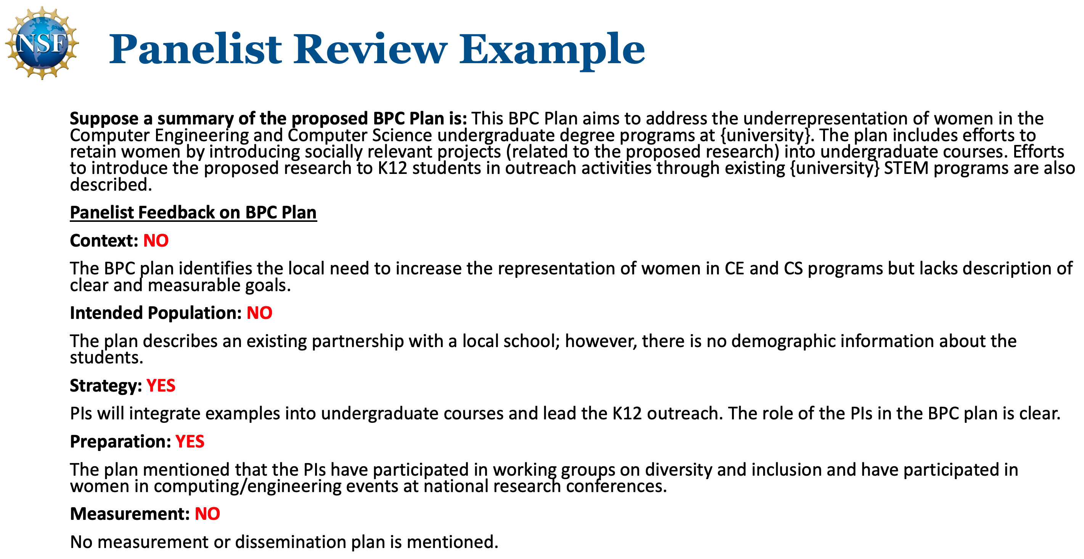

Slide 18
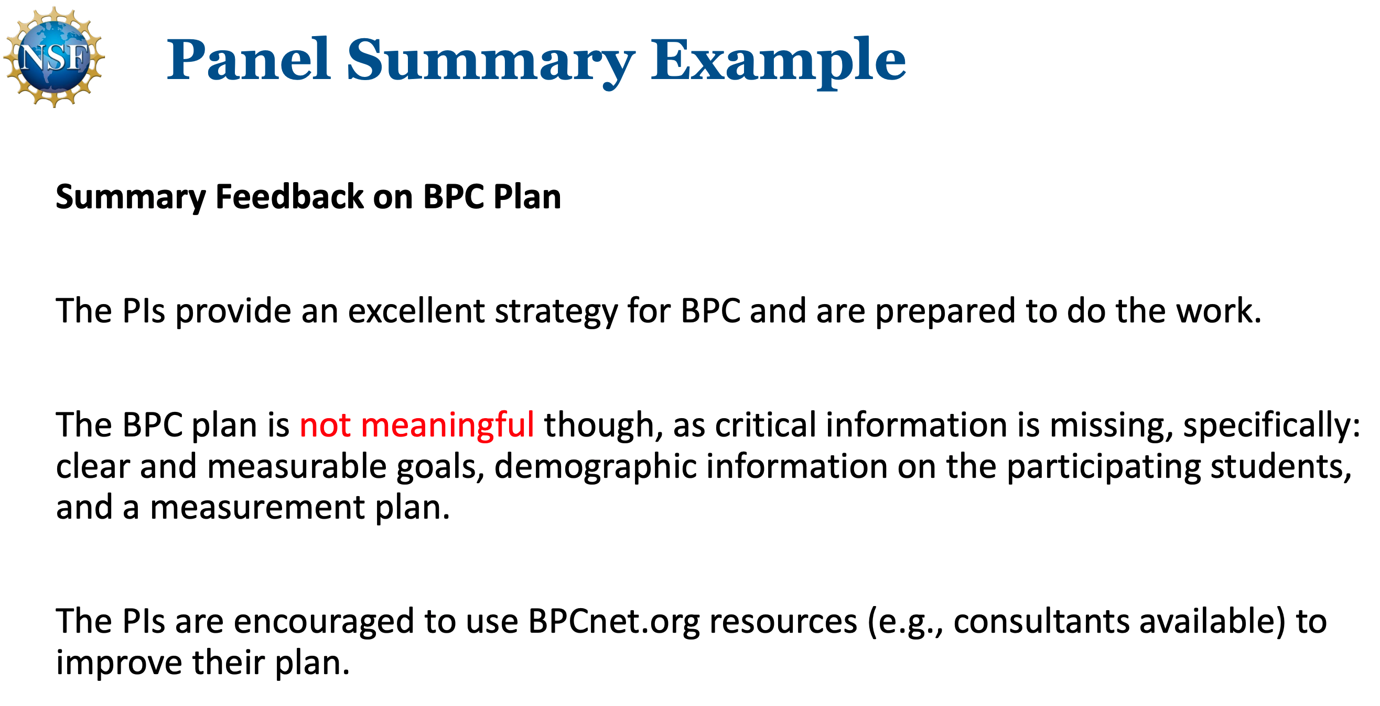

Slide 19
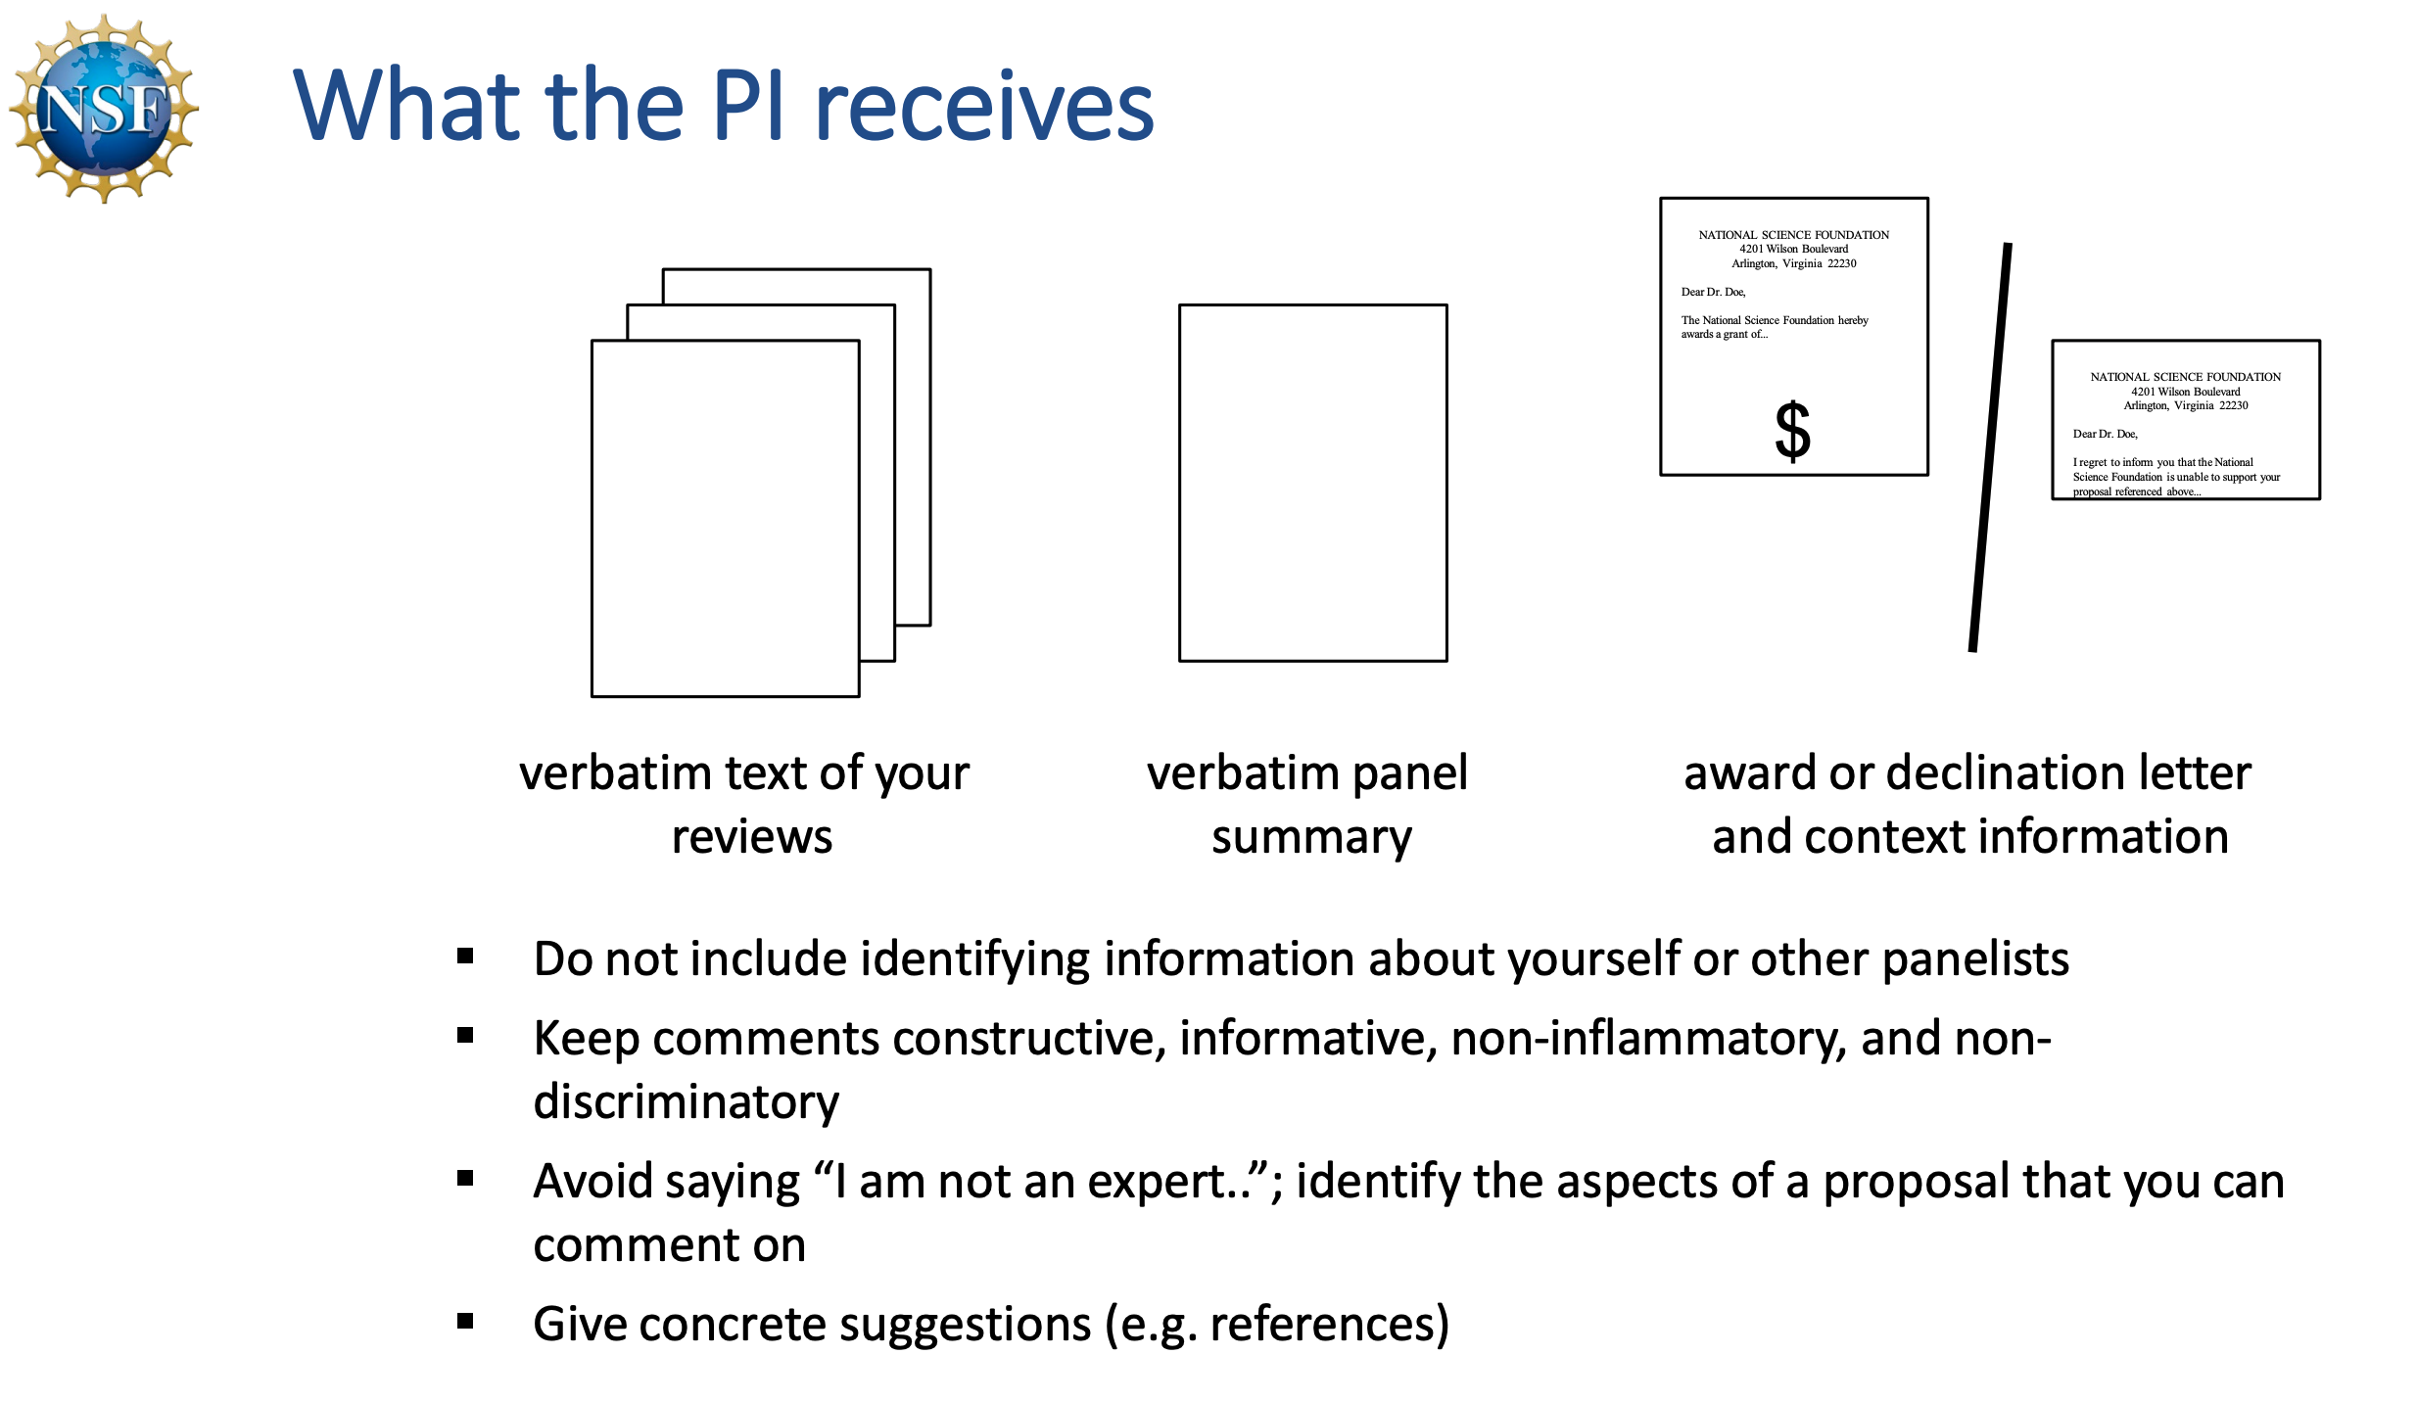

Slide 20


Slide 21
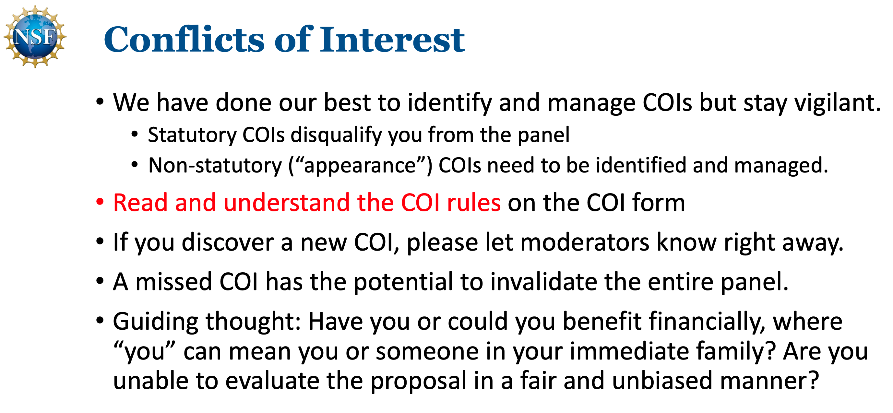

Slide 22
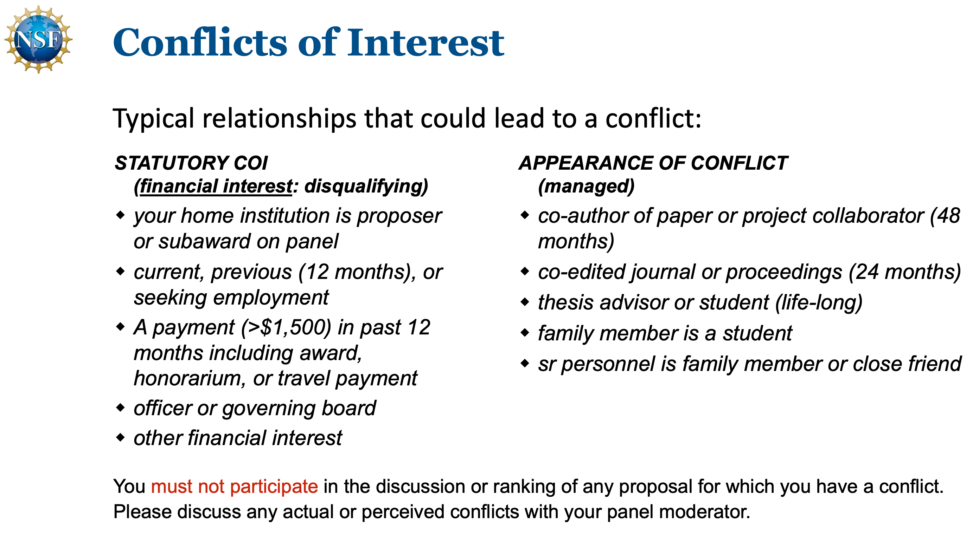

Slide 23
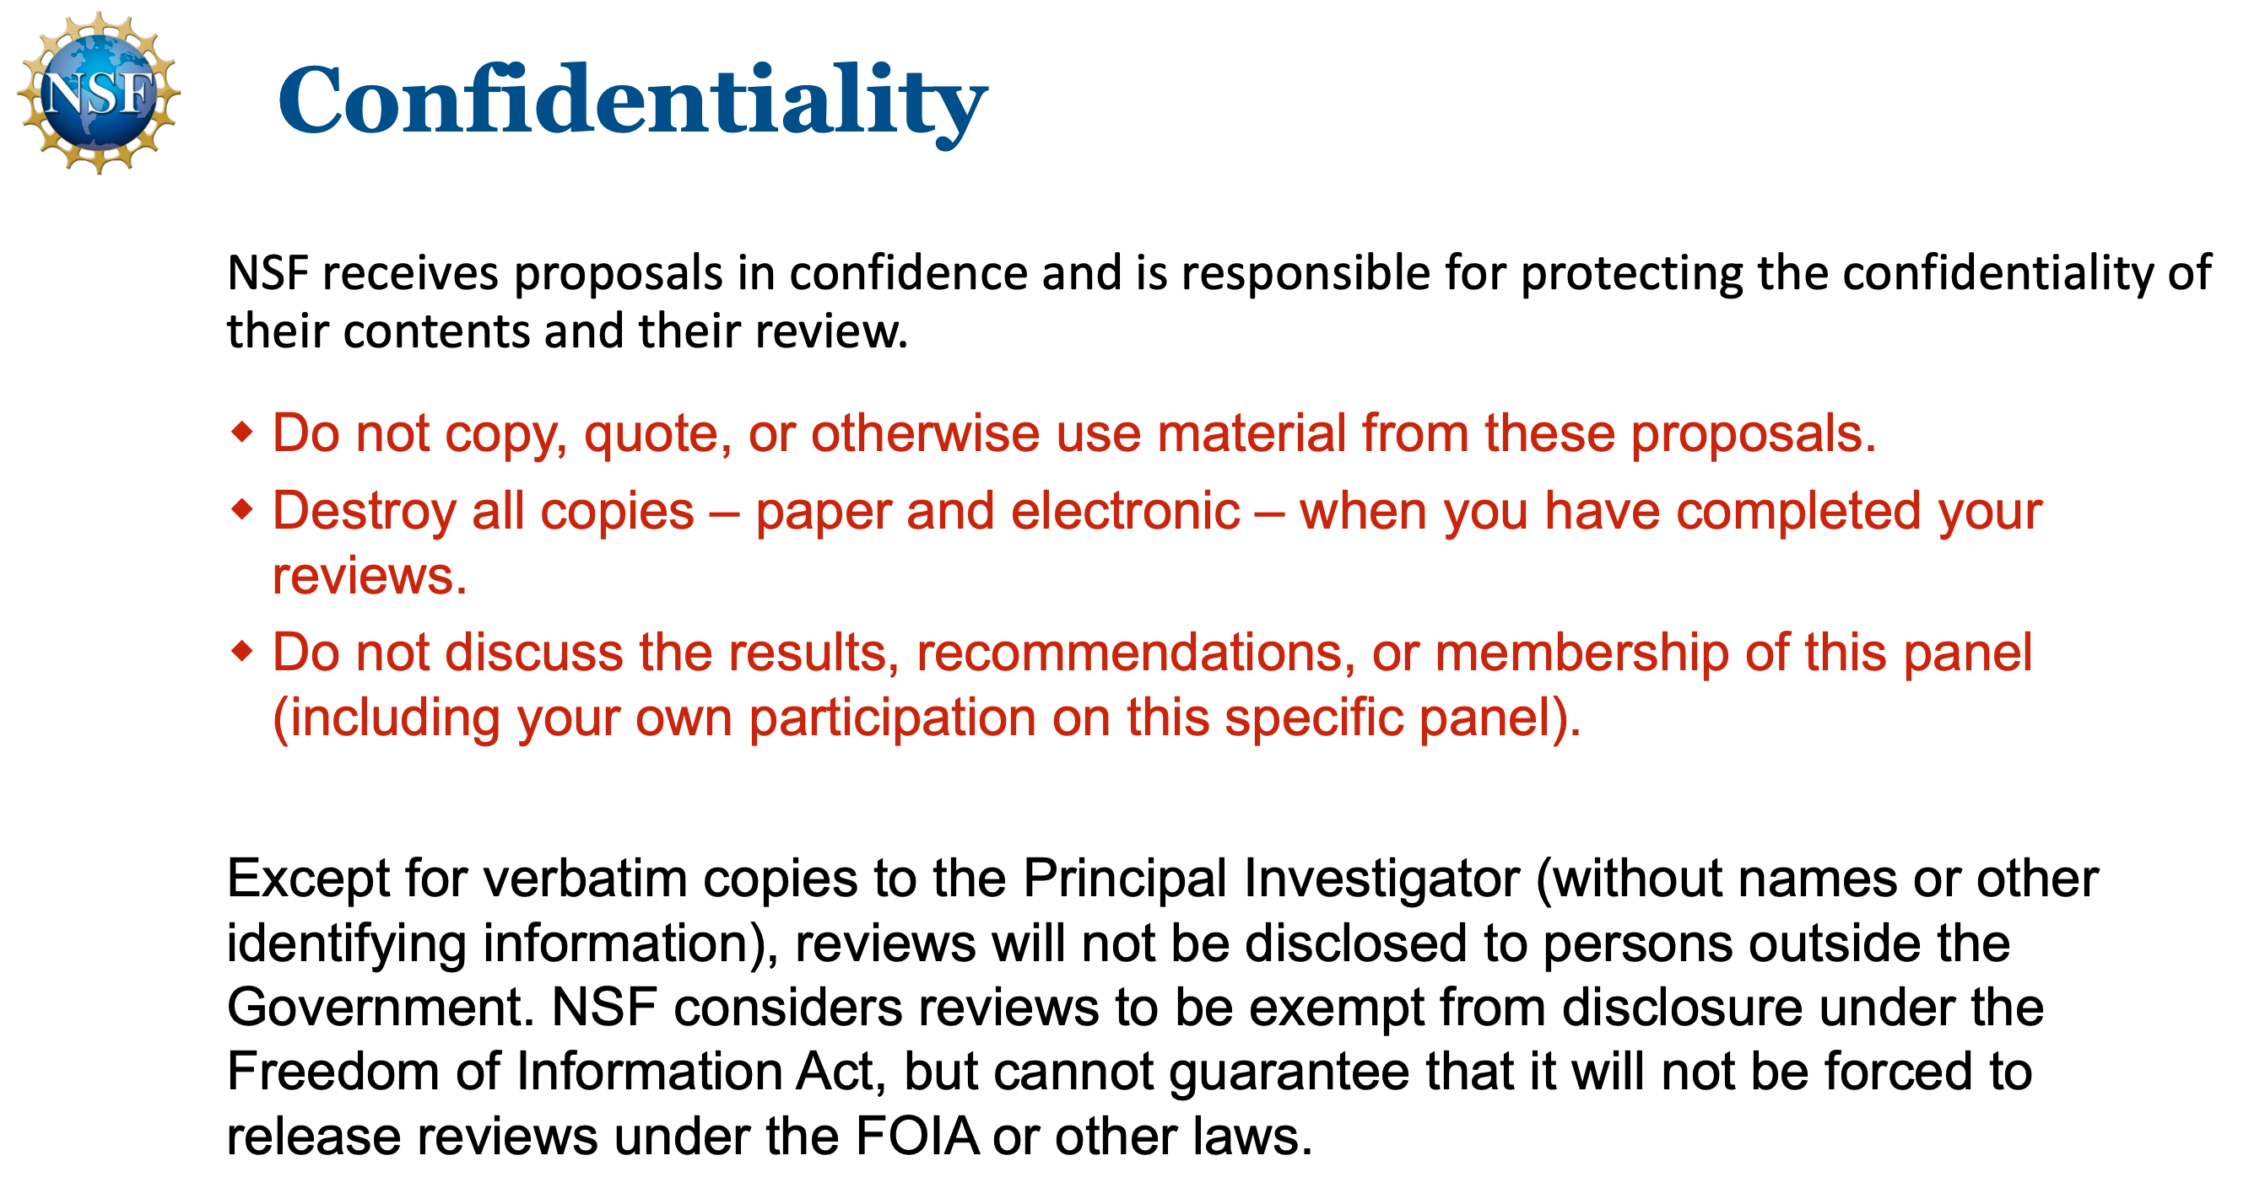

Slide 24
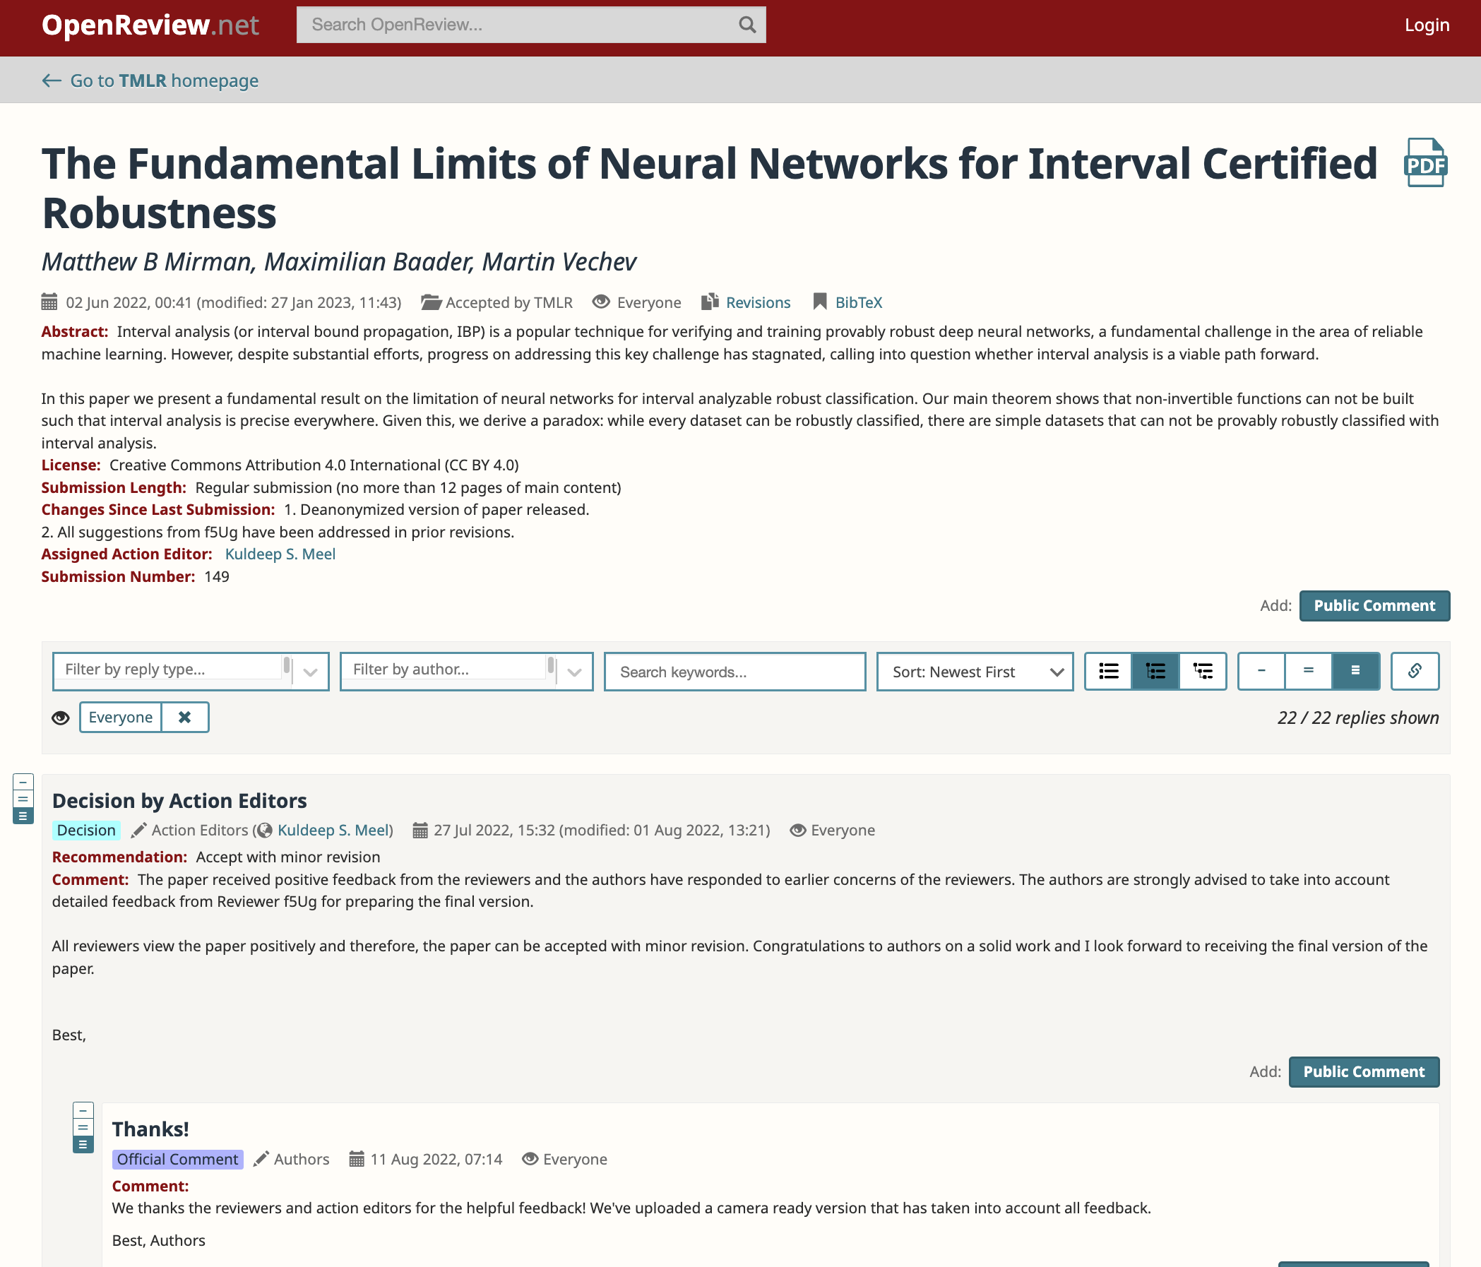
https://openreview.net/forum?id=fsacLLU35V&noteId=0YZBFu5GSG

